Slide 1


Open4um
MEMBER
THÁI
THÔNG
THIỆN
TOÀN
NGHĨA
CHI

Slide 2
Mybatis
Mariadb
Sping MVC
JSP-servlet
API momo
JavaScript SDK
Công nghệ

Slide 3
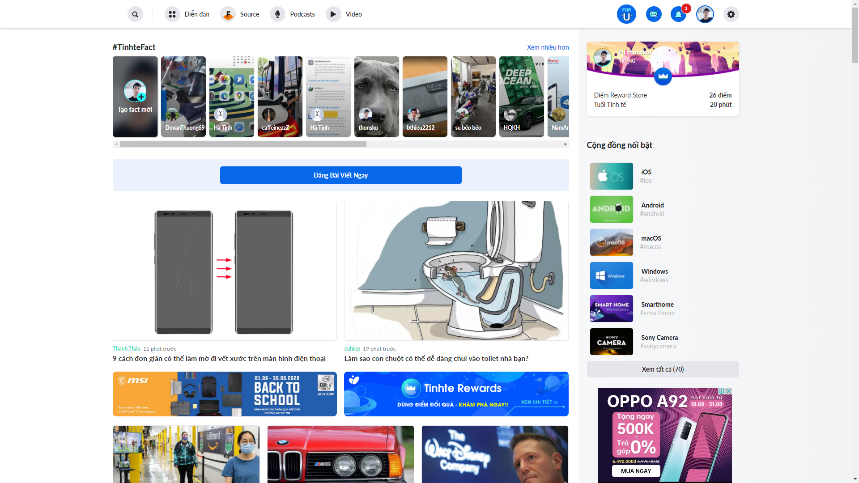
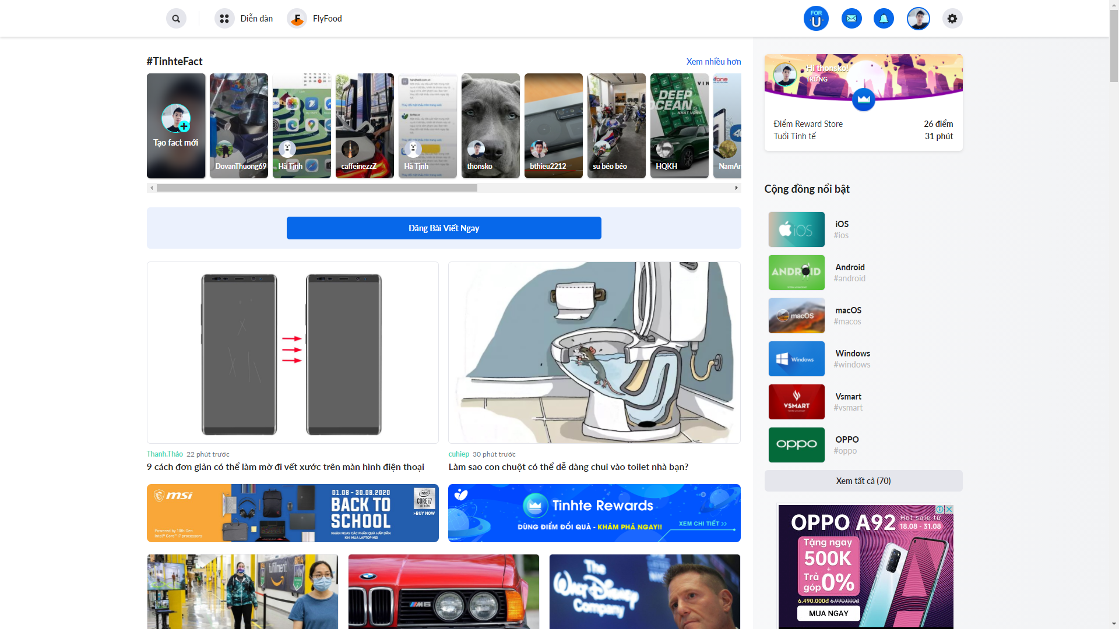


Slide 4
Knowledge
Discuss
Login
Forum
Source
Reference
Trade

Slide 5
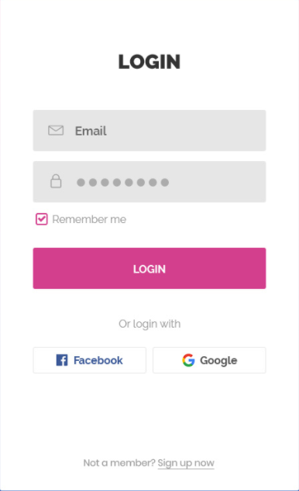


Slide 6

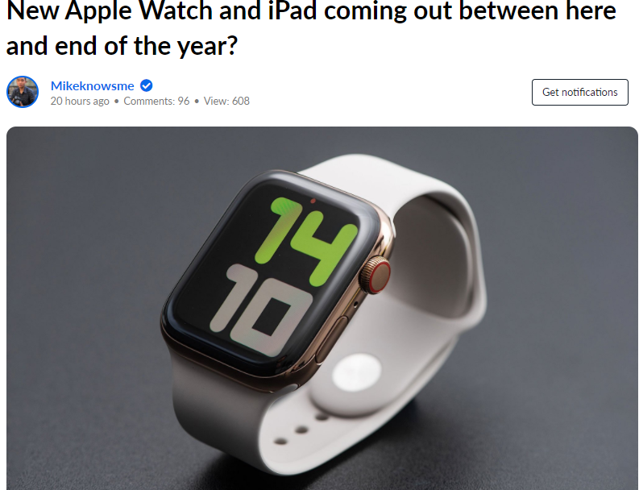

FORUM

Slide 7
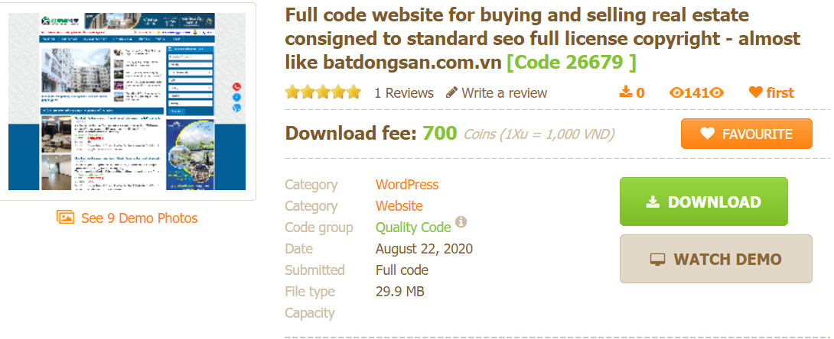
SOURCE

Slide 8
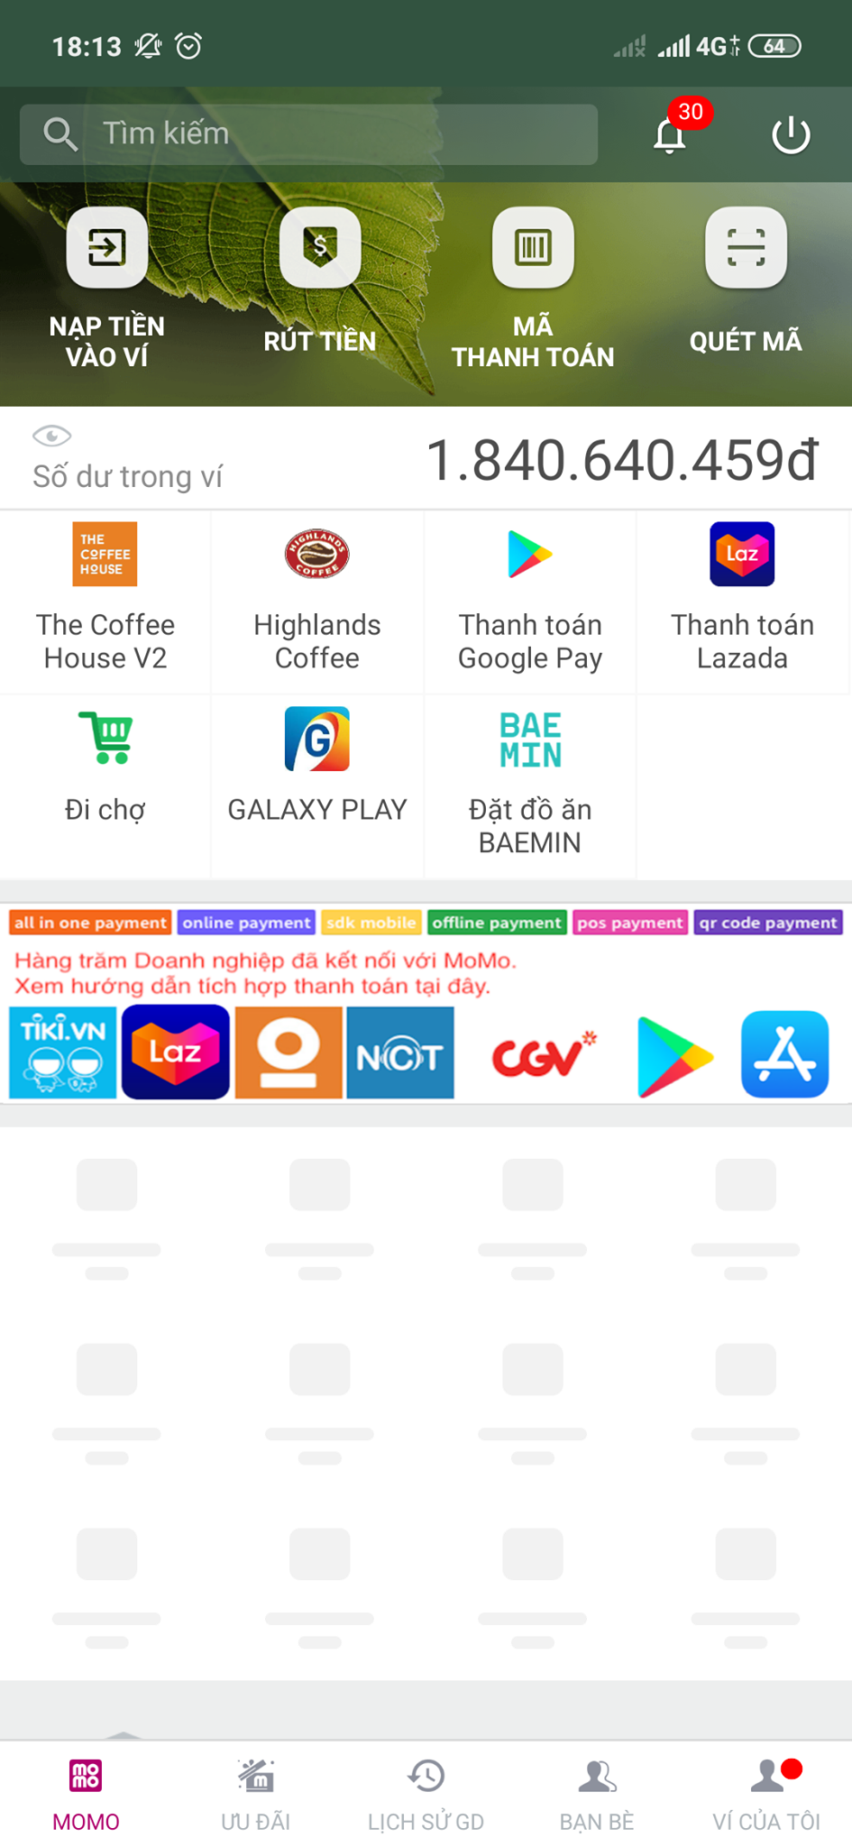
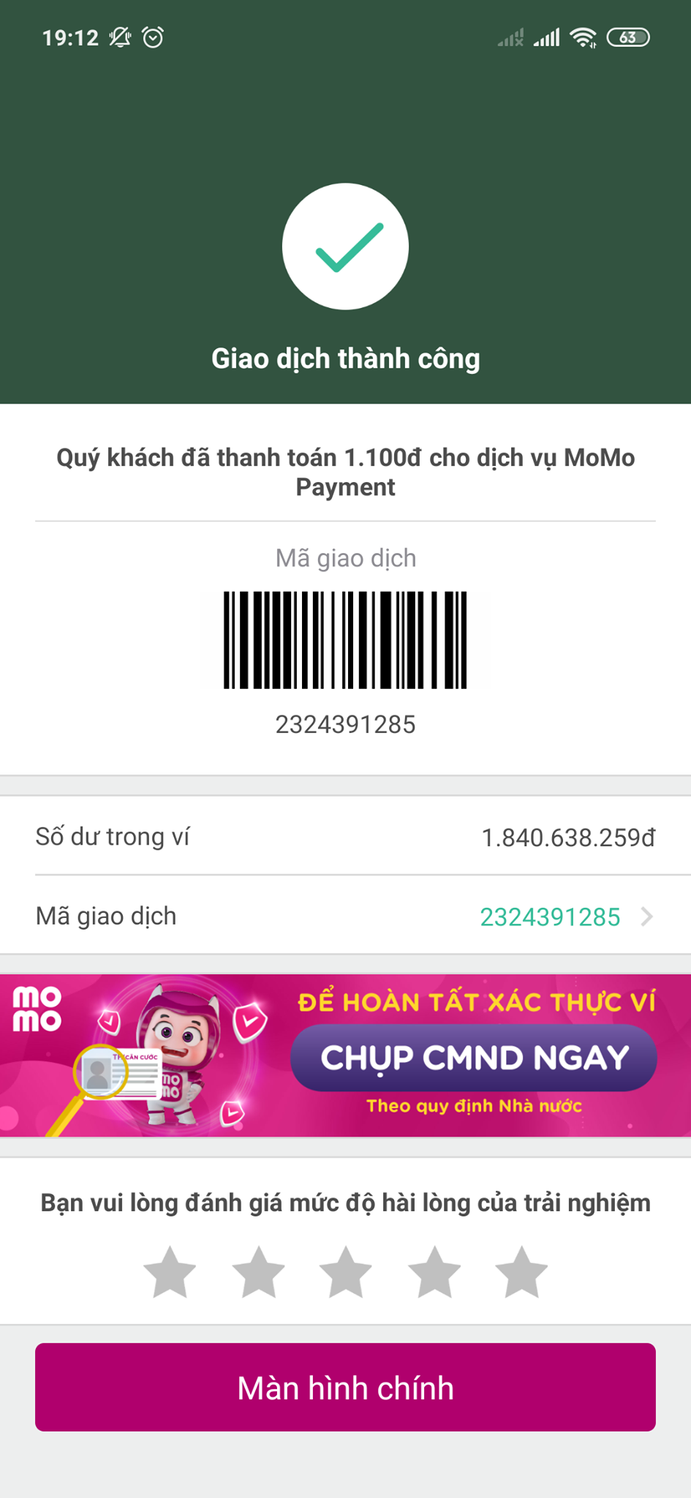
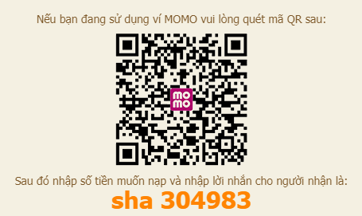

Slide 9

EVERYDAY, MEMBERS PUSH TO BRANCH. THEN LEADER WILL MERGE ON FRIDAY.

Slide 10
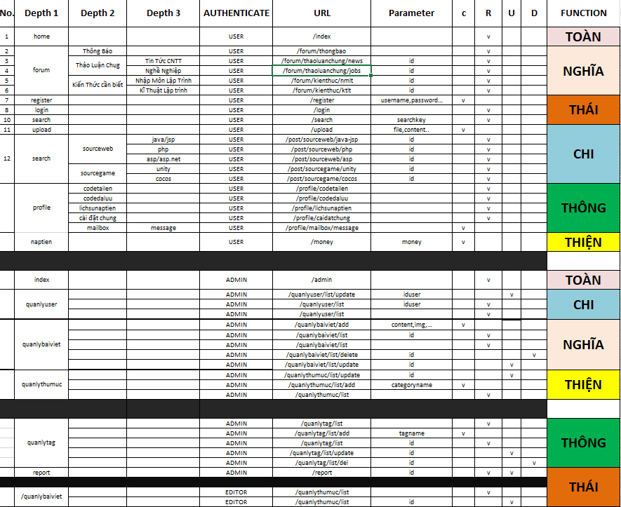

Slide 11

THE END
THANK FOR WATCHING

